Slide 1

By
Jason Gu
Gautam Kapoor
Nikhil Vytla

Slide 2
The Game
A minimalist version of Connect4
GUI Built In (Using Java Swing and SwingX, NOT Gridworld)
Networking

Slide 3

The Team
Gautam Kapoor
Jason Gu
Nikhil Vytla
GUI God
Stack Overflow Researcher
Team Carry

Slide 4
Specifications
Implemented the NetGames package as the skeleton to our code
4 Classes
Main
Window
Represents the board when starting, playing, or finishing a game
Game State
The state of a game played and defining the actions of each player
Game Hub
Allows for networking connections using Serializable

Slide 5
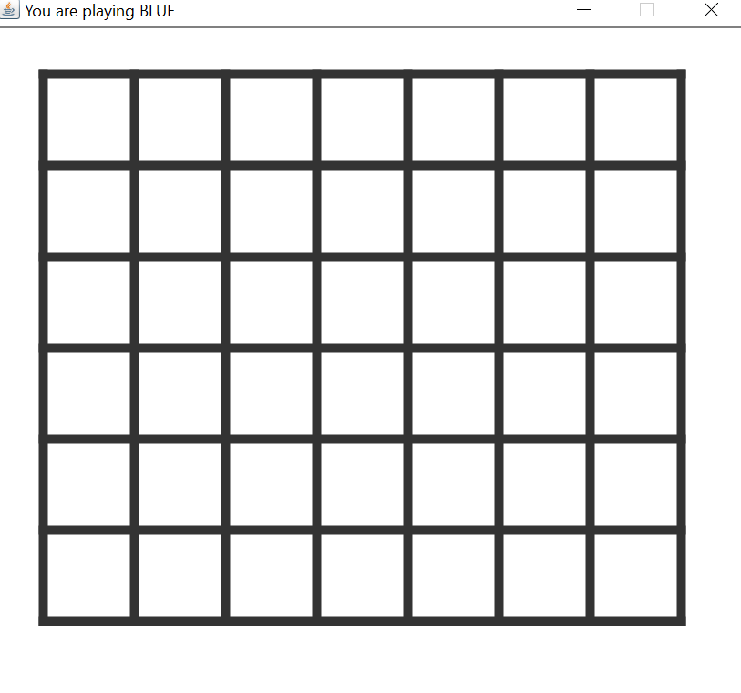
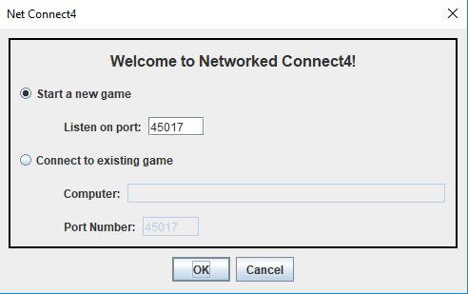
Game Window

Slide 6
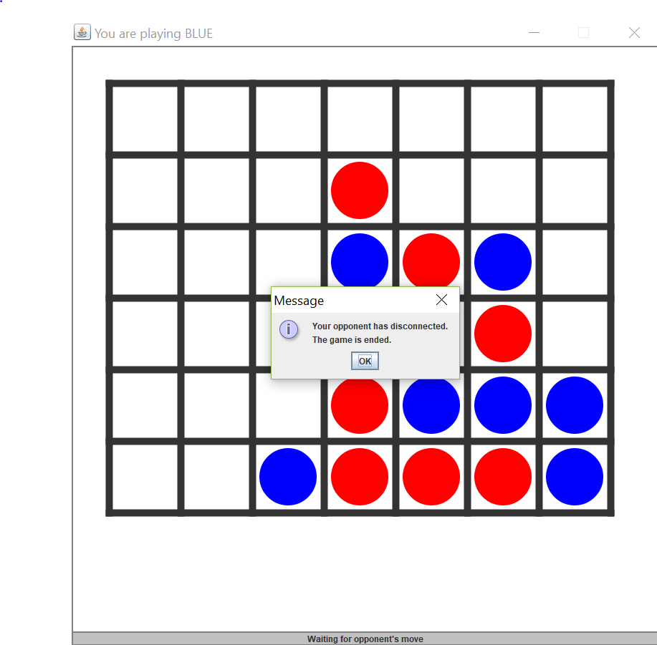
Game Hub
Networking Class
One hub that both players connect to
Transmits each move to the window
Allows only 2 players to connect
When one player disconnects it informs the other player

Slide 7
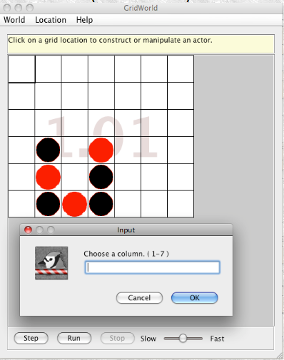
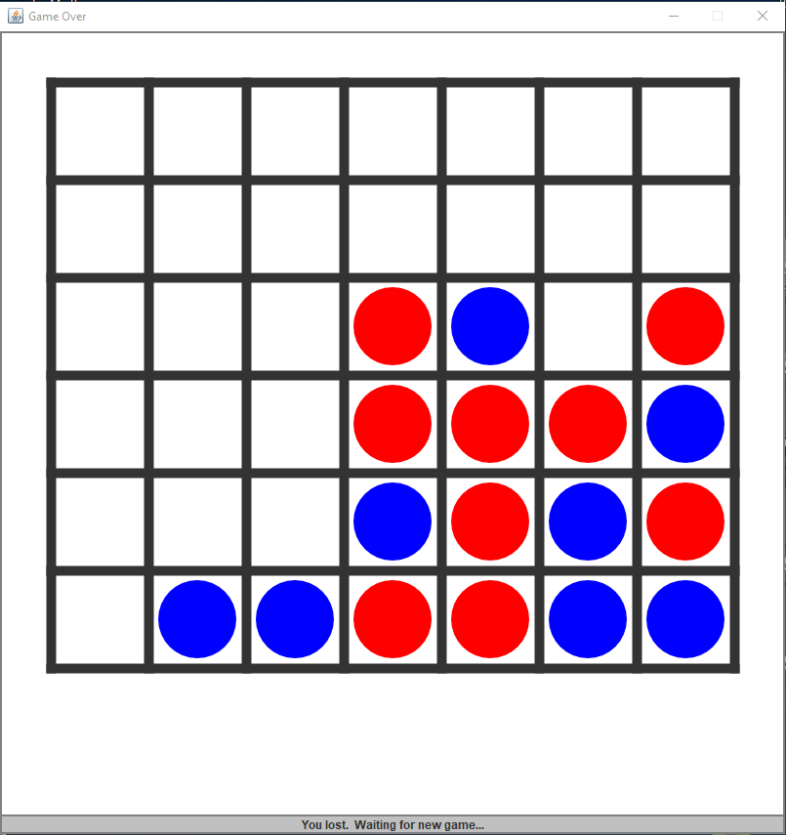
Game State
Java GUI library not optimized to run our game
Created our own Java GUI using basic Java Code
Serializable
Needed for networking
Travels an object across a network
Turns it into a byte stream

Slide 8
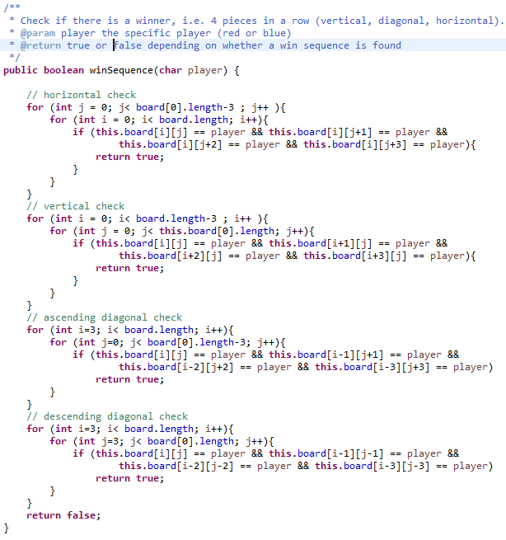
Win Sequence Algorithms

Slide 9
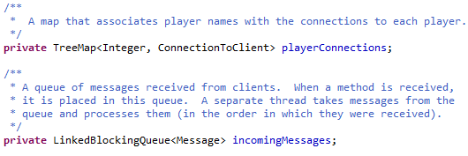
Awesome Coding Features!
Located in our Hub class (cited in netgame.common)

Slide 10
TreeMap
Similar to a Hashmap
Sorted in ascending order of its keys
We use it for connecting Players with their Messages/Movements

Slide 11
LinkedBlockingQueue
Queue with a first-in first-out (FIFO) order
Head of the queue is element that has been on the queue the longest time
We use it for storing messages from each user

Slide 12
How to Play + Demo Time!
Link to USER MANUAL: https://docs.google.com/document/d/1FBxP5C_-tzmVu51b4gYTWWHnpfCQ4DnH4rQjd-jVUiM/edit?usp=sharing

Slide 13
Reflections + The Future of C4Entertainment
Tried using Gridworld, but realized very late that Gridworld didn’t work for us
Clear sense of direction + technology used
Add more interactive features to Connect4
Mobile version in development!

